Slide 1
In the name of Allah, most gracious and merciful
Object Oriented Concepts &Design with Lab
Lecture – 6
Polymorphism

Slide 2
polymorphism
The word polymorphism means having many forms. In object-oriented programming paradigm, polymorphism is often expressed as 'one interface, multiple functions'.
Polymorphism can be static or dynamic. In static polymorphism, the response to a function is determined at the compile time. In dynamic polymorphism, it is decided at run-time.

Slide 3
Static Polymorphism
Which method is to be called is decided at compile-time only. Method overloading is an example of this. Method overloading is a concept where we use the same method name many times in the same class, but different parameters. Depending on the parameters we pass, it is decided at compile-time only. The same method name with the same parameters is an error and it is a case of duplication of methods which C# does not permit. In Static Polymorphism the decision is made at compile time.
C# provides two techniques to implement static polymorphism. They are:
Function overloading
Operator overloading

Slide 4
Function Overloading
You can have multiple definitions for the same function name in the same scope. The definition of the function must differ from each other by the types and/or the number of arguments in the argument list. You cannot overload function declarations that differ only by return type.

Slide 5
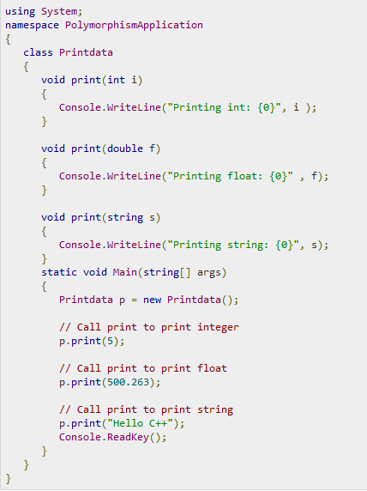

Slide 6
Dynamic Polymorphism
Run time polymorphism is also known as method overriding. In this mechanism by which a call to an overridden function is resolved at a Run-Time (not at Compile-time) if a base Class contains a method that is overridden. Method overriding means having two or more methods with the same name, same signature but with different implementation. In this process, an overridden method is called through the reference variable of a superclass, the determination of the method to be called is based on the object being referred to by reference variable.

Slide 7
A virtual function, is basically saying look, here's the functionality that may or may not be good enough for the child class. So if it is good enough, use this method, if not, then override me, and provide your own functionality.

Slide 8
What is Virtual Function:
They implement the concept of polymorphism; are the same as in C#, except that you use the override keyword with the virtual function implementation in the child class. The parent class uses the same virtual keyword. Every class that overrides the virtual method will use the override keyword. Why to use them:
It is not compulsory to mark the derived/child class function with override keyword while base/parent class contains a virtual method
Virtual methods allow subclasses to provide their own implementation of that method using the override keyword
Virtual methods can't be declared as private.
You are not required to declare a method as virtual. But, if you don't, and you derive from the class, and your derived class has a method by the same name and signature, you'll get a warning that you are hiding a parent's method
A virtual property or method has an implementation in the base class, and can be overriden in the derived classes.
We will get a warning if we won't use Virtual/New keyword.
Instead of Virtual we can use New Keyword

Slide 9
